Slide 1
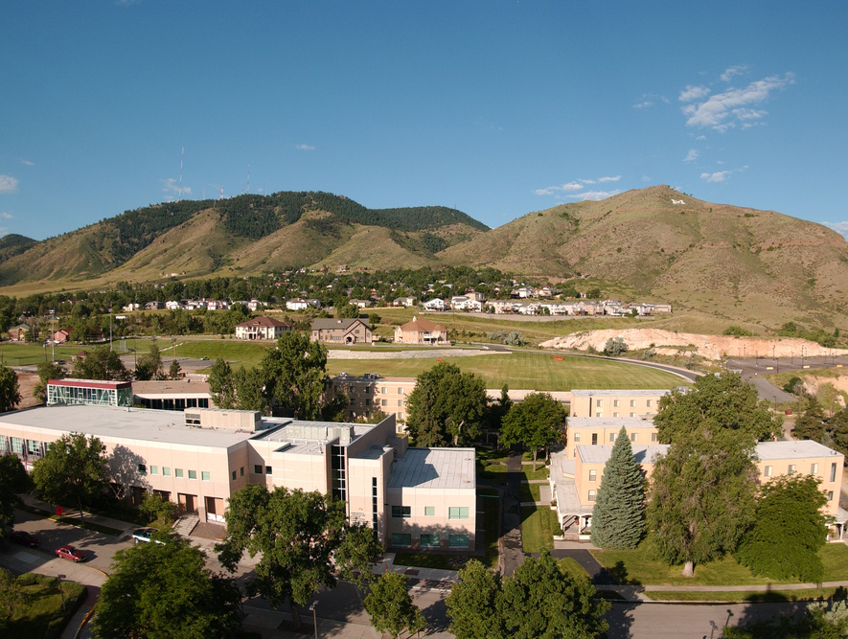
Colorado School of Mines
Computer Vision
Professor William Hoff
Dept of Computer Science
http://inside.mines.edu/~whoff/

Slide 2
RANSAC

Slide 3


Identifying Correct Matches
Let’s say that we want to match points from one image to another
We detect feature points in each image (e.g., SIFT or SURF points) and then match their descriptors
Now we have a set of matching pairs, but some are incorrect
How do we identify the correct matches?
Graffiti image dataset from http://kahlan.eps.surrey.ac.uk/featurespace/web/data.htm

Slide 4
SIFT Points from each image
Number of features detected: 1741
Number of features detected: 2052

Slide 5
Tentative matches
Tentative matches (based on feature descriptors): 442

Slide 6
Fitting a Transformation
As we have seen in a previous class, we can fit a transformation between the two images
Then, only accept those matches that allow a good transformation to be fit
Possible transforms include
Affine
Homography
We can calculate transformations from corresponding points
However, incorrect correspondences (outliers) will corrupt our estimate

Slide 7
One Solution: Least Median of Squares (LMS)
“Median”: is the middle of a sorted list of numbers
LMS finds the solution that minimizes the median of the squared error, instead of the sum of the squared errors
Ignores large errors
Handles outliers up to 50%
outliers
Squared error
median

Slide 8
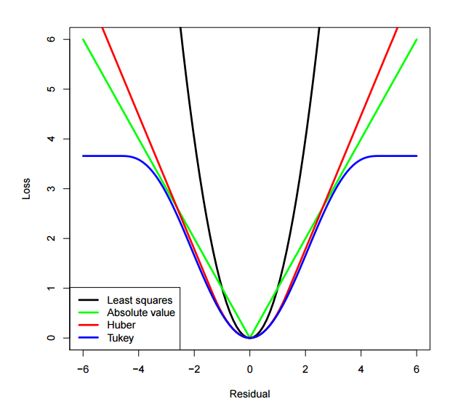
Another Solution: Robust estimator
Use a modified objective function, which down-weights the influence of large errors
These are called “M-estimators” because they are (M)inimizing a loss function
Most commonly minimize sum of squared errors
Can also minimize sum of absolute errors
Or some more complicated measure that trades off between these two methods. Each of these has a different profile in terms of how much “outliers” are discounted!
From: http://web.as.uky.edu/statistics/users/pbreheny/764-F11/notes/12-1.pdf

Slide 9
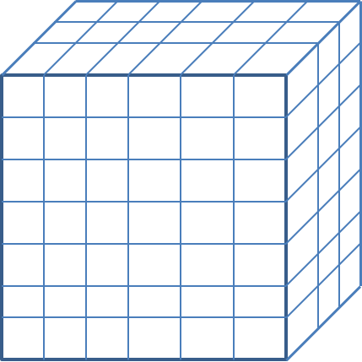
Large Numbers of Outliers
If the outliers are a large fraction (>50%) of the data, then these methods don’t work well
You can do some kind of clustering, or voting method
We saw how to use “pose clustering” to identify (likely) good matches, by voting into a discrete accumulator space
Another method is called RANSAC (Random Sample Consensus)

Slide 10
Algorithm (RANSAC)
1) Randomly select a minimal set of points and solve for the transformation
2) Count the number of points that agree with this transformation
3) If this transformation has the highest number of inliers so far, save it
4) Repeat for N trials and return the best transformation
Then, optionally use standard least square fitting to fit the transformation to all the inliers

Slide 11
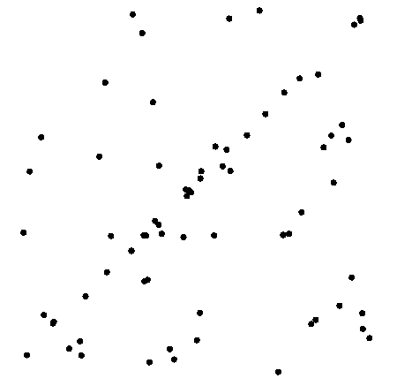
Example: line fitting
We will randomly select subsets of 2 points (since 2 is the minimum number of points to fit a line)

Slide 12
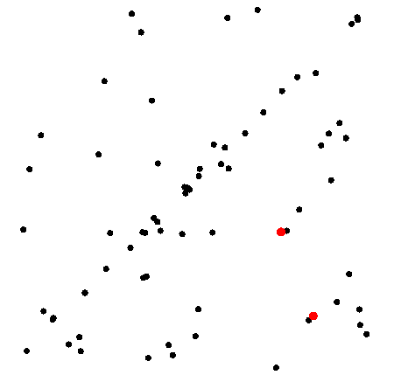
Example: line fitting
n=2

Slide 13
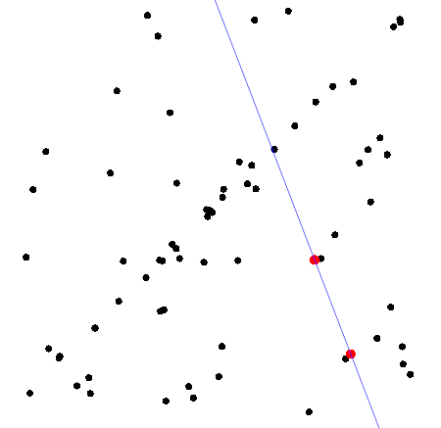
Model fitting

Slide 14
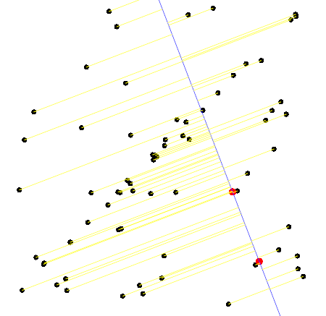
Measure distances

Slide 15
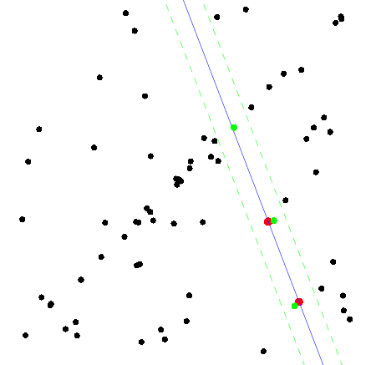
Count inliers
c=3

Slide 16
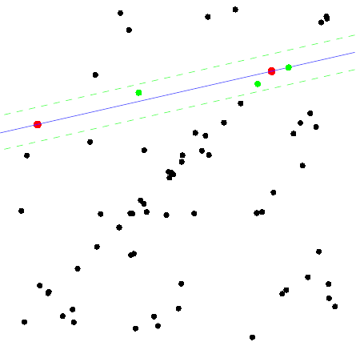
Another trial
c=5

Slide 17
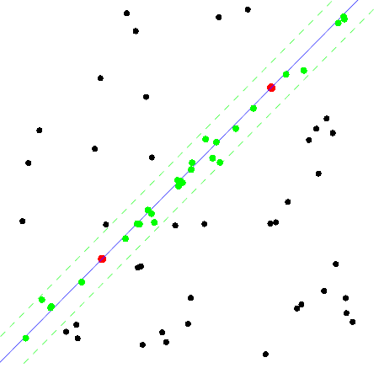
The best model
c=27

Slide 18
RANSAC Algorithm
“Random Sample Consensus”
Can be used to find inliers for any type of model fitting
Surprisingly effective!
Widely used in computer vision
Requires two parameters:
The number of trials N (how many do we need?)
The agreement threshold (how close does an inlier have to be?)
Fischler, M. A., & Bolles, R. C. 1981. Random sampling consensus: A paradigm for model fitting with applications to image analysis and automated cartography. Communications of the Associations for Computing Machinery, 24(26), 381–395.

Slide 19
Number of samples (trials) required
We want to take enough random samples to that we are sure (to a high probability) that at least one of the samples is all inliers
Simple example
Say you have a bag of good and bad widgets (equal number of each)
We reach in and grab a sample of 3 widgets
Do this 25 times
What is the probability that at least one sample has all good widgets?
Solution
The probability of getting all good widgets is 0.5^3 = 0.125
The probability of a bad, or corrupted sample (ie, at least one bad widget) is 1 – 0.125 = 0.875
If we do this 25 times, the probability of all the samples being bad is 0.875^25 = 0.0355
The probability that at least one of the samples is good is 1 – 0.0355 = 0.965

Slide 20
Number of samples – general solution
Assume we know ε, the probability that a point is an outlier
So (1- ε) is the probability that any point is an inlier
The probability that a sample of size s is all inliers is (1- ε)^{s}
So 1-(1- ε)^{s} is the probability of getting at least one outlier in that sample
With N samples (trials), the probability that all samples have at least one outlier is p_{alloutliers} = (1-(1- ε)^{s} )^{N}
We want at least one sample to have no outliers. The probability is p_{notalloutliers} = 1 - p_{alloutliers}
We’ll pick p_{notalloutliers} to be some high value, like 0.99.
If we know ε, we can solve for N
N is the number of trials needed to get at least one sample of all inliers, with probability p_{notalloutliers}
Notes:
Do example: e = 0.5, p = 0.99, s = 2, N = 10

Slide 21
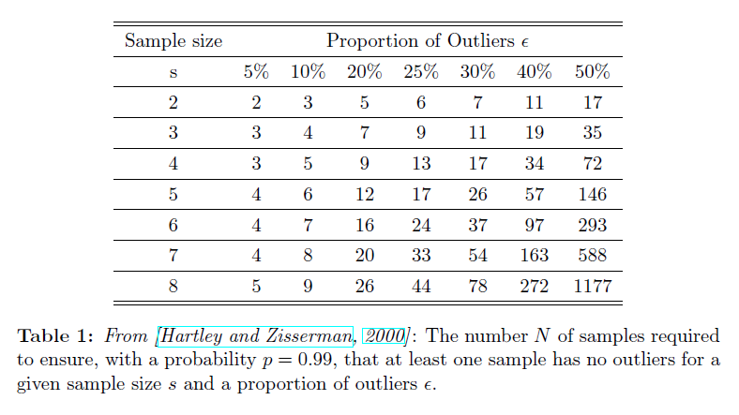
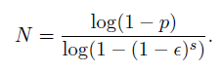
Number of samples required

Slide 22
Better estimate for N (if #pts is small)
Again, assume we know ε, the probability that a point is an outlier
So (1- ε) is the probability that any point is an inlier
Assume we have M total points. The estimated number of inliers is $n_{inlier}=\left(1−ε\right)M$
The number of ways we can pick a sample of s points out of M points is $m=\left(\begin{matrix}M \\ s\end{matrix}\right)$
The number of ways we can choose s points that are all inliers is $n=\left(\begin{matrix}n_{inlier} \\ s\end{matrix}\right)$
The probability that any sample of s points is all inliers is p=n/m
“n choose k” is the number of ways to choose k items from a set of n items
N is the number of trials needed to get at least one sample of all inliers, with probability p_{notalloutliers}

Slide 23
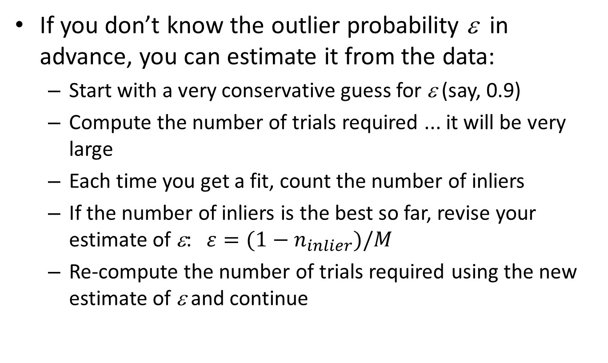
Estimating outlier probability
If you don’t know the outlier probability ε in advance, you can estimate it from the data:
Start with a very conservative guess for ε (say, 0.9)
Compute the number of trials required ... it will be very large
Each time you get a fit, count the number of inliers
If the number of inliers is the best so far, revise your estimate of ε: $ε=(1−n_{inlier})/M$
Re-compute the number of trials required using the new estimate of ε and continue

Slide 24
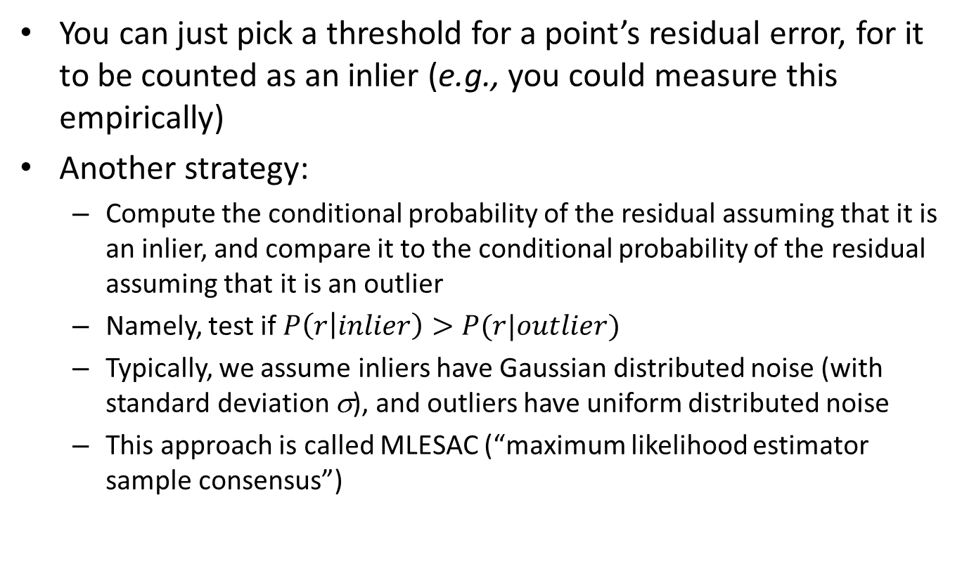
Deciding if a point is an inlier
You can just pick a threshold for a point’s residual error, for it to be counted as an inlier (e.g., you could measure this empirically)
Another strategy:
Compute the conditional probability of the residual assuming that it is an inlier, and compare it to the conditional probability of the residual assuming that it is an outlier
Namely, test if $P\left(r | inlier\right)>P(r|outlier)$
Typically, we assume inliers have Gaussian distributed noise (with standard deviation σ), and outliers have uniform distributed noise
This approach is called MLESAC (“maximum likelihood estimator sample consensus”)
P. H. S. Torr , A. Zisserman, "MLESAC: A new robust estimator with application to estimating image geometry" , Computer Vision and Image Understanding, vol 78 Issue 1, April 2000, pp 138 - 156.
http://www.robots.ox.ac.uk/~vgg/publications/2000/Torr00/torr00.pdf

Slide 25
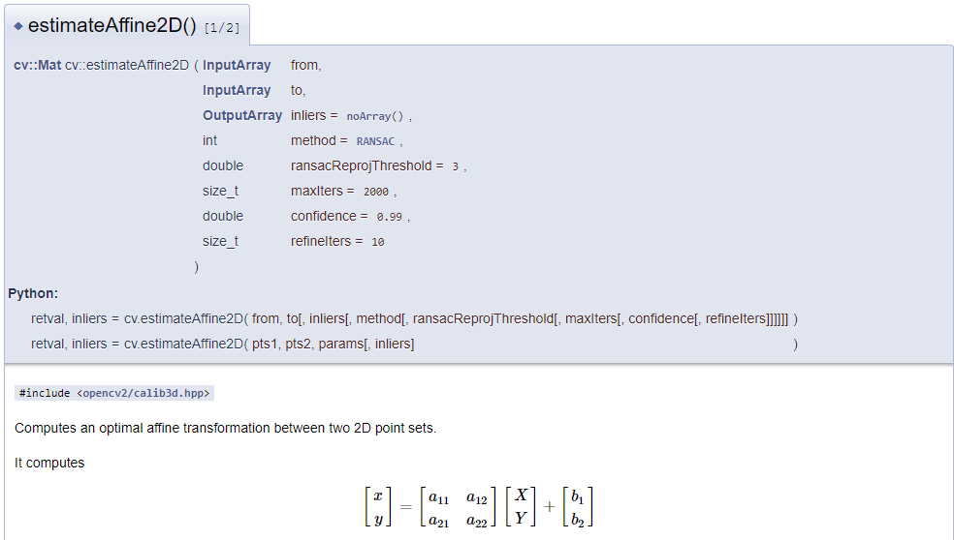
OpenCV
Most transform estimation functions have a RANSAC option
https://opencv.org/

Slide 26
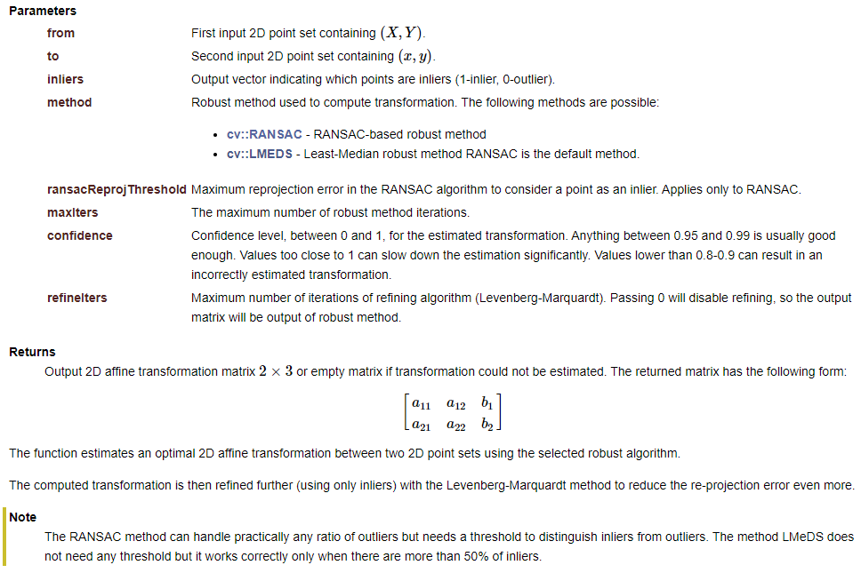

Slide 27
Demo
Modify object detection program from last week
Use RANSAC to fit affine transformation
Don’t need pose clustering
# Calculate an affine transformation from the training image to the query image. def calc_affine_transformation(matches_in_cluster, kp_train, kp_query): if len(matches_in_cluster) < 3: # Not enough matches to calculate affine transformation. return None, None # Estimate affine transformation from training to query image points. src_pts = np.float32([kp_train[m.trainIdx].pt for m in matches_in_cluster]).reshape( -1, 1, 2) dst_pts = np.float32([kp_query[m.queryIdx].pt for m in matches_in_cluster]).reshape( -1, 1, 2) A_train_query, inliers = cv2.estimateAffine2D( src_pts, dst_pts, method=cv2.RANSAC, ransacReprojThreshold=3, # Default = 3 maxIters=2000, # Default = 2000 confidence=0.99, # Default = 0.99 refineIters=10 # Default = 10 ) return A_train_query, inliers

Slide 28
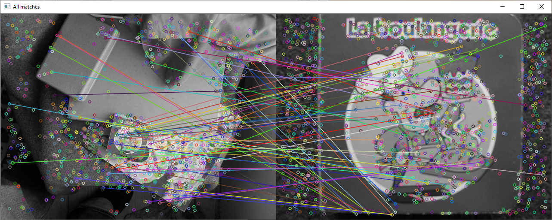
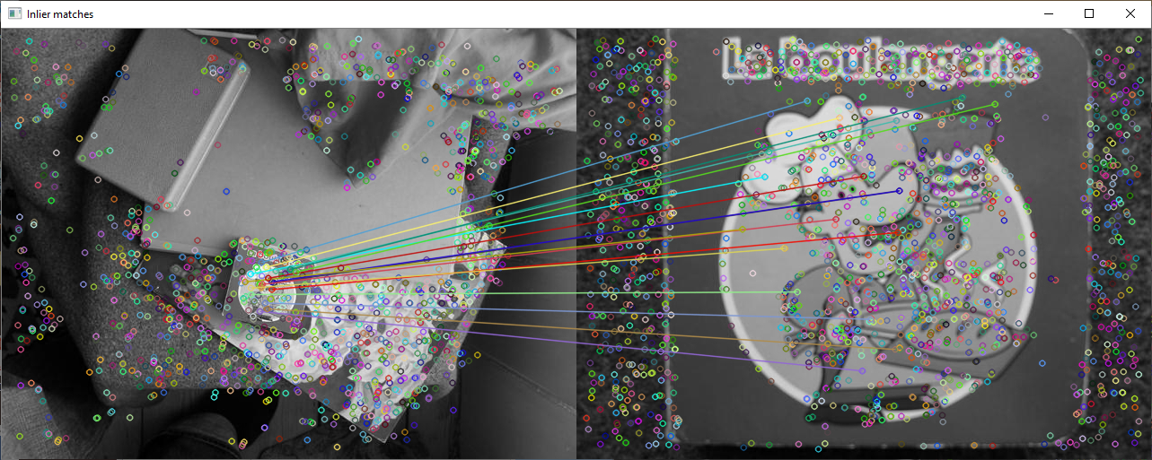
63 matches
17 inliers

Slide 29
import os import cv2 import numpy as np IMAGE_DIRECTORY = "images" TRAINING_IMAGE_NAME = "book1.pgm" QUERY_IMAGE_NAME = "Img01.pgm" MINIMUM_MATCHES = 5 def main(): file_path = os.path.join(IMAGE_DIRECTORY, TRAINING_IMAGE_NAME) assert(os.path.exists(file_path)) bgr_train = cv2.imread(file_path) # Get training image file_path = os.path.join(IMAGE_DIRECTORY, QUERY_IMAGE_NAME) assert(os.path.exists(file_path)) bgr_query = cv2.imread(file_path) # Get query image # Show input images. cv2.imshow("Training image", bgr_train) cv2.imshow("Query image", bgr_query) # Extract keypoints and descriptors. kp_train, desc_train = detect_features(bgr_train, show_features=False) kp_query, desc_query = detect_features(bgr_query, show_features=False) matcher = cv2.BFMatcher.create(cv2.NORM_L2) # Match query image descriptors to the training image. # Use k nearest neighbor matching and apply ratio test. matches = matcher.knnMatch(desc_query, desc_train, k=2) good = [] for m, n in matches: if m.distance < 0.8 * n.distance: good.append(m) matches = good print("Number of raw matches between training and query: ", len(matches))
Object detection program (1 of 2)

Slide 30
bgr_matches = cv2.drawMatches( img1 = bgr_query, keypoints1 = kp_query, img2 = bgr_train, keypoints2 = kp_train, matches1to2 = matches, matchesMask = None, outImg = None) cv2.imshow("All matches", bgr_matches) # Calculate an affine transformation from the training image to the query image. A_train_query, inliers = calc_affine_transformation(matches, kp_train, kp_query) matches = [matches[i] for i in range(len(matches)) if inliers[i] == 1] bgr_matches = cv2.drawMatches( img1 = bgr_query, keypoints1 = kp_query, img2 = bgr_train, keypoints2 = kp_train, matches1to2 = matches, matchesMask = None, outImg = None) cv2.imshow("Inlier matches", bgr_matches) # Apply the affine warp to warp the training image to the query image. if A_train_query is not None and sum(inliers) >= MINIMUM_MATCHES: # Object detected! Warp the training image to the query image and blend the images. print("Object detected! Found %d inlier matches" % sum(inliers)) warped_training = cv2.warpAffine( src=bgr_train, M=A_train_query, dsize=(bgr_query.shape[1], bgr_query.shape[0])) # Blend the images. blended_image = bgr_query / 2 blended_image[:, : ,1] += warped_training[:, :, 1] / 2 blended_image[:, :, 2] += warped_training[:, :, 2] / 2 cv2.imshow("Blended", blended_image.astype(np.uint8)) else: print("Object not detected; can't fit an affine transform") cv2.waitKey(0)
Object detection program (2 of 2)

Slide 31
Number of samples
In this case, we had 17 inliers out of 63
27% inliers, or 73% outliers (ε = 0.73)
For affine transform, sample size is s=3
Our desired confidence is p_{notalloutliers} = 0.99
So N = 232

